Slide 1
From Allesandro Lenci

Slide 2
Linguistic Ontologies
Mikrokosmos (Nirenburg, Mahesh et al.)
Generalized Upper Model (Bateman et al.)
WordNet (Miller, Fellbaum et al.)
  EuroWordNet (Vossen et al.)
Sensus (Hovy, Knight, et al.)
SIMPLE (Calzolari, Lenci et al.)

Slide 3
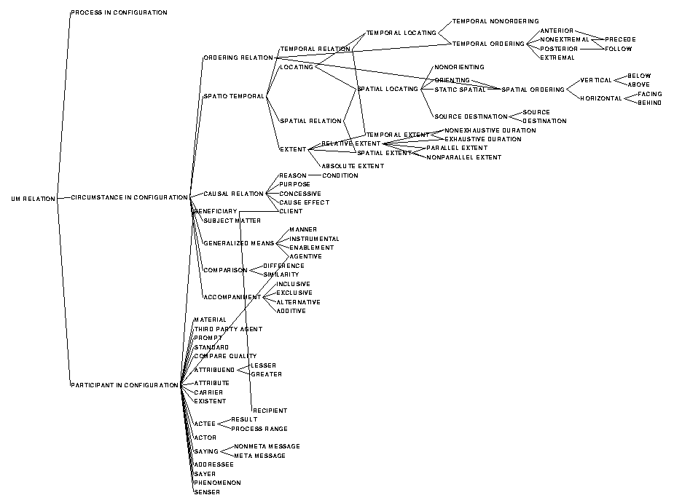
The Relational Hierarchy
The Relational Hierarchy

Slide 4
Linguistic Ontologies design issues
Network based
  hierarchy (taxonomy)
    WordNet
  heterarchy
    SIMPLE
Frame based
  Mikrokosmos
  Generative Lexicon

Slide 5
Linguistic Ontologies
SIMPLE
<fabbricare>
make
Ala (wing)
Agentive
SemU: 3232
Type: [Part]
Part of an airplane
Agentive
<volare>
fly
Used_for
Is_a_part_of
<aeroplano>
airplane
Isa
SemU: 3268
Type: [Part]
Part of a building
Isa
<parte>
part
Used_for
SemU: D358
Type: [Body_part]
Organ of birds for flying
Isa
<edificio>
building
Is_a_part_of
Is_a_part_of
SemU: 3467
Type: [Role]
Role in football
<giocatore>
player
<uccello>
bird
Isa

Slide 6
Linguistic Ontologies
SIMPLE heterarchy of relations
Top
Formal
Constitutive
Agentive
Telic
Is_a
Is_a_part_of
Property
Created_by
Agentive_cause
Indirect_telic
Activity
...
Contains
...
Instrumental
Is_the_habit_of
Used_for
Used_as

Slide 7
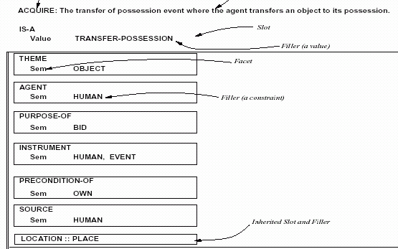
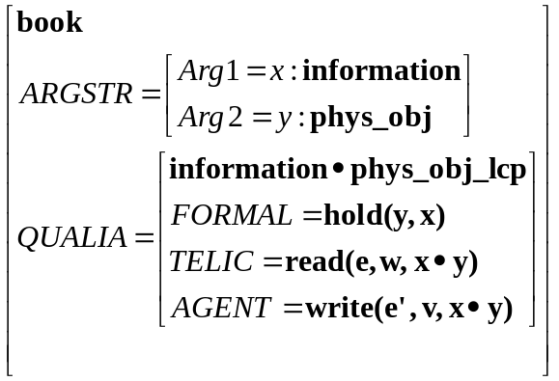
Linguistic Ontologies frames
Generative Lexicon
Mikrokosmos

Slide 8
Concepts, Words and Meanings
NLP
Semantic knowledge
KR&M
Two Views on Semantic Content
Top-down approach
  The semantic content of a word is defined by its coordinates within an ontology of concepts
Bottom-up approach
  The semantic content of a word is defined by the distributional co-occurrence patterns of that word

Slide 9
Concepts, Words and Meanings
Top-down view
  Words express meanings corresponding to semantic types
  Semantic types are defined by a symbolic system (ontology) of conceptual categories independent of (and yet linked to) the concrete uses of words in context
  The actual instantiation of a meaning in context is a token of a given semantic type

Slide 10
The Top-Down View
Semantic type systems (ontologies) provide explicit, directly processable representations of word content
  Discrete and symbolic view of lexical meaning
  Support inferential mechanisms
Language independent representation (e.g. multilinguality, etc.)
Complex concepts are explained by symbol syntactic combinations
Respond quite nicely to the language engineering demands for reusable semantic resources in machine readable form
Linguistic ontologies are “hand-made”

Slide 11
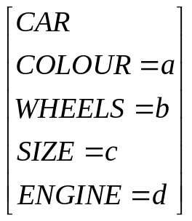

Concepts and Symbols
Traditional view of concepts (Barsalou 1992):
  amodal symbols
  de-situated
  invariant through experiential situations

Slide 12
Meanings and Symbols
car
Traditional view of semantic types:
  context-free
  discrete
  invariant through linguistic contexts
  represented by “language-extrinsic” logical forms

Slide 13
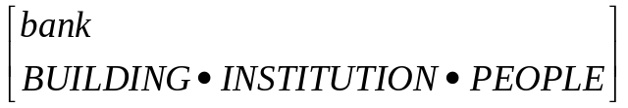
Polysemy
bank₁ (Hanks 2000)
  IS AN INSTITUTION
  IS A LARGE BUILDING
  FOR STORAGE
  FOR SAFEKEEPING
  OF FINANCE/MONEY
  CARRIES OUT TRANSACTIONS
  CONSISTS OF A STAFF OF PEOPLE
bank₂
  IS LAND
  IS SLOPING
  IS LONG
  IS ELEVATED
  SITUATED BESIDE RIVER
(Pustejovsky 1995)

Slide 14
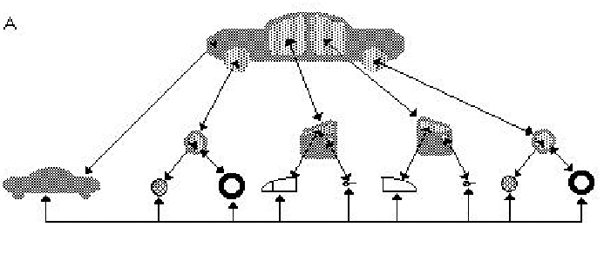
Perceptual Symbols
(Barsalou 1999)
a frame of car integrating different perceptual symbols
Concepts as simulators
  generating mechanisms producing simulations of instances

Slide 15
Linguistic Symbols
“Like a perceptual symbol, […] a linguistic symbol is not an amodal symbol, nor does an amodal symbol ever develop in conjunction with it. Instead, a linguistic symbol develops just like a perceptual symbol. As selective attention focuses on spoken and written words, schematic memories extracted from perceptual states become integrated into simulators that later produce simulations of these words in recognition, imagination and production”
(Barsalou 2000:592)

Slide 16
Semantic Multidimensionality
Concepts expressed by lexical items are multidimensional entities
No Functionality | dog, stone, man
Relational | member, father, bishop
Functionality | player, lawyer, chair
Artifactuality | chair, airplane, etc.
Temporal duration | pedestrian, passenger
Agentivity | killer, lawyer

Slide 17
Conceptual Complexity
Concepts differ for their internal structural complexity (cf. Keil 1989)
natural kind
uomo “man”
musicista “musician”
orchestrale “orchestra player”
natural kind + functionality
natural kind + functionality + relational

Slide 18
Dimensions of Meaning
Concepts are systems of dimensions
  words lexicalize the concept, its dimensions, the possible values of these dimensions
Ontology are system of concepts
Ontology Learning vs. Concept Learning

